Slide 1

Ketch
Beaton / Butler / Carder / Greeson

Slide 2

Initial Login
Profiles Linked To Unique FaceBook Users
Login Is Used At The Beginning And Then Again In A Few Other Circumstances

Slide 3
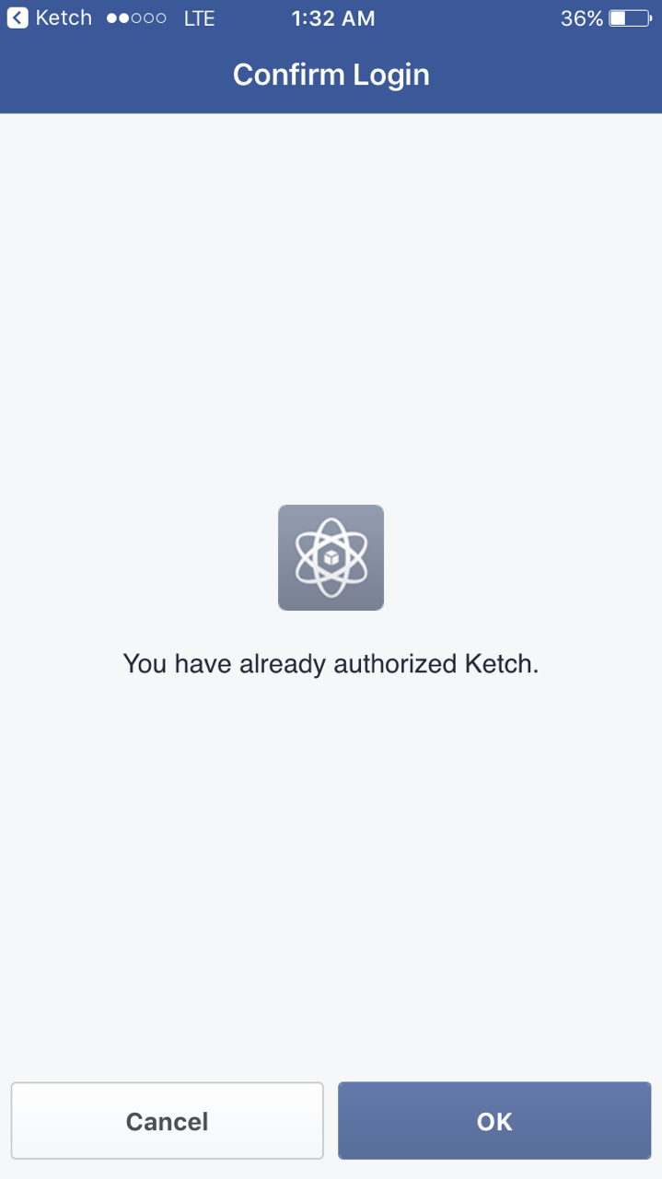
Authorization
Authorization Only Occurs Once And Is Linked To Your Account Even If You Log Out

Slide 4
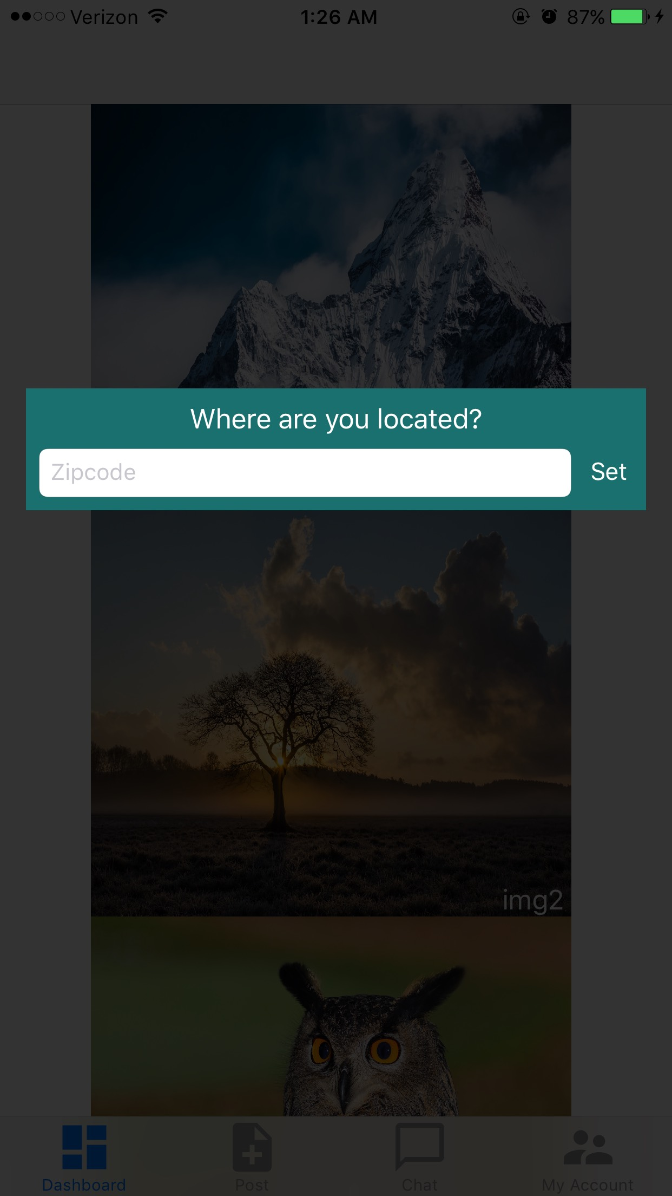
Setting Location
Upon First Entering The Application, Zip Code Is To Be Set By The User
Zip Can Later Be Changed By The User On The Account Page

Slide 5
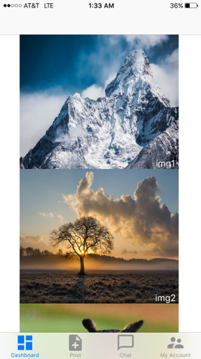
Dashboard
User Can Select An Image Pulling Up Item Page
User Can Navigate Throughout All Functions On The Application

Slide 6
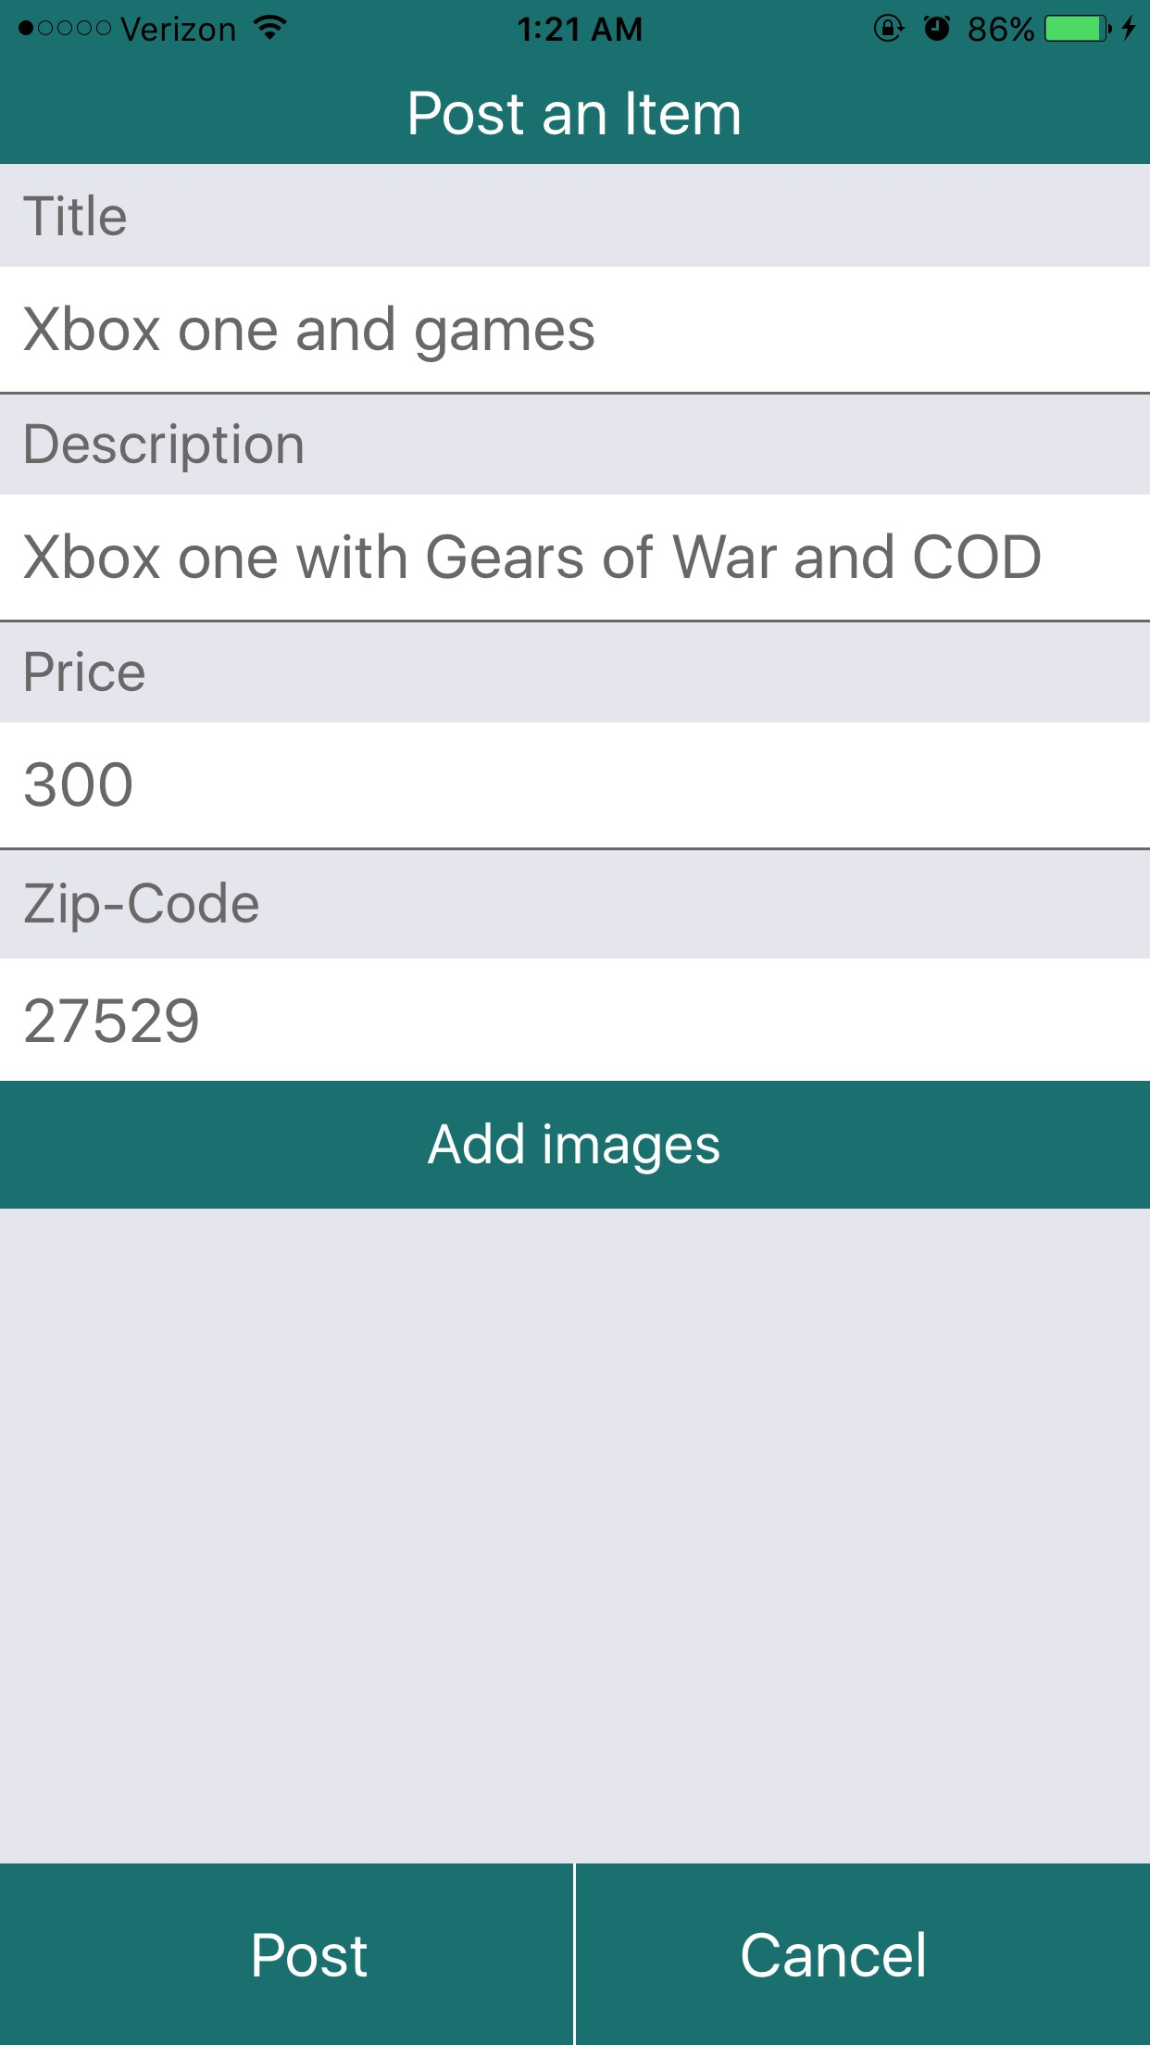
Item Posting
User Can Input Information About An Item For Sale
User Can Upload A Picture For Said Item
User Sets Zip Code In Which To Sale The Item

Slide 7
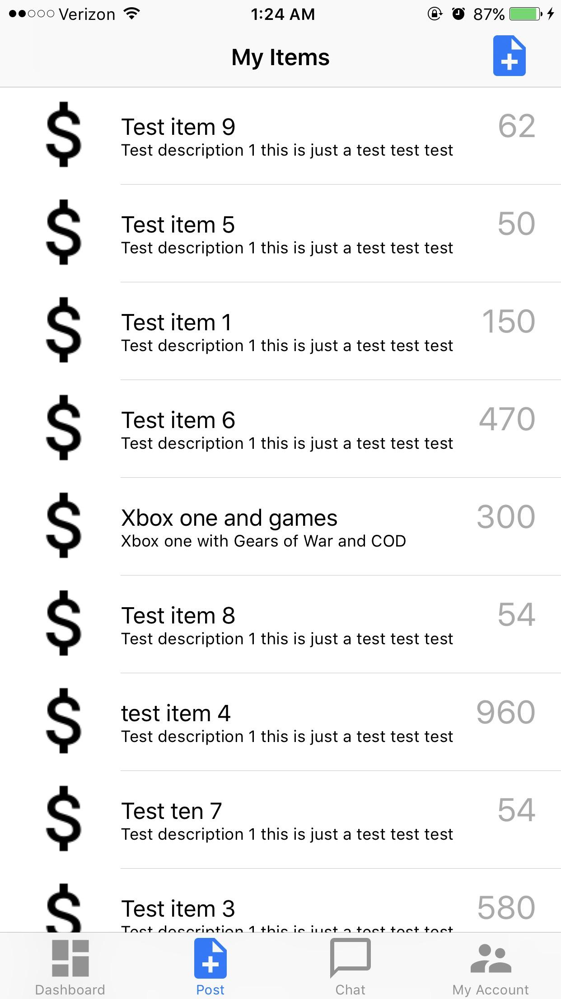
Seller Item Listings
User May Set Up An Item For Sale
User May Click Item To Change Details
User Can Click Item To See Potential Buyers

Slide 8
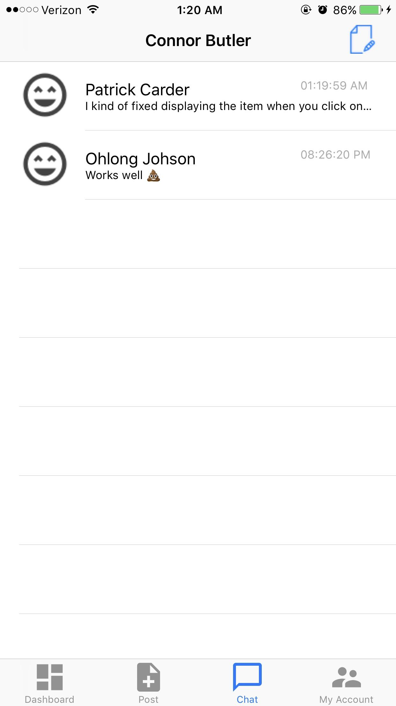
Message Function
This Main Page Focuses On All Of The Messages Between Each Buyer And Seller
Can Click On An Individual Person To Go To That Specific Chat
Admins Can Go To A Specific Page That Allows You To See All Users On Application

Slide 9
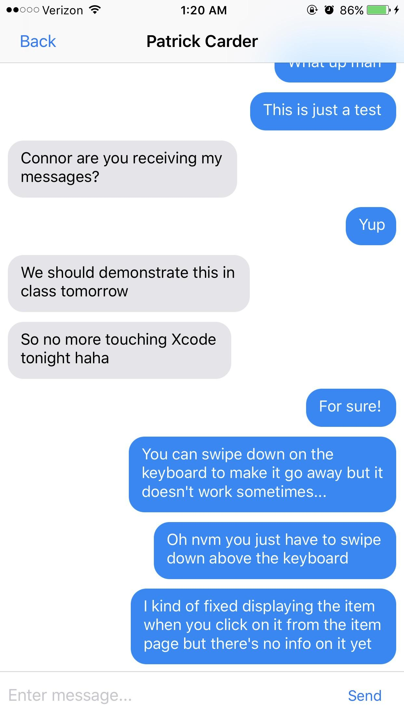
Individual Messages
Typical Messaging System That Looks Very Similar To iOS Messaging

Slide 10
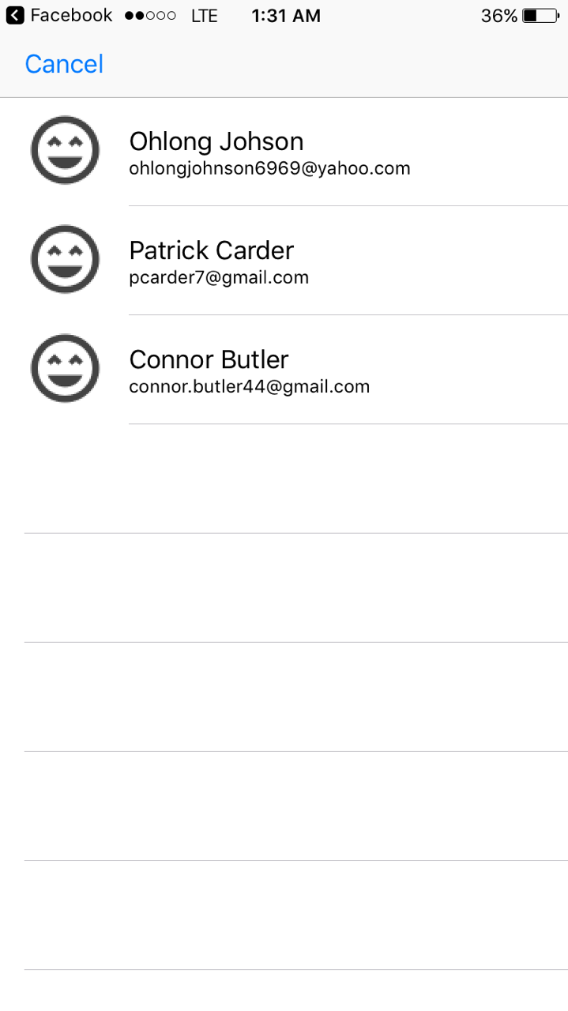
Admin Panel of Users
Allows Admins To View The Accounts Of All Users
Admins Can Change/Delete Accounts
Location Of This Function May Be Changed To An Admins Account Page

Slide 11
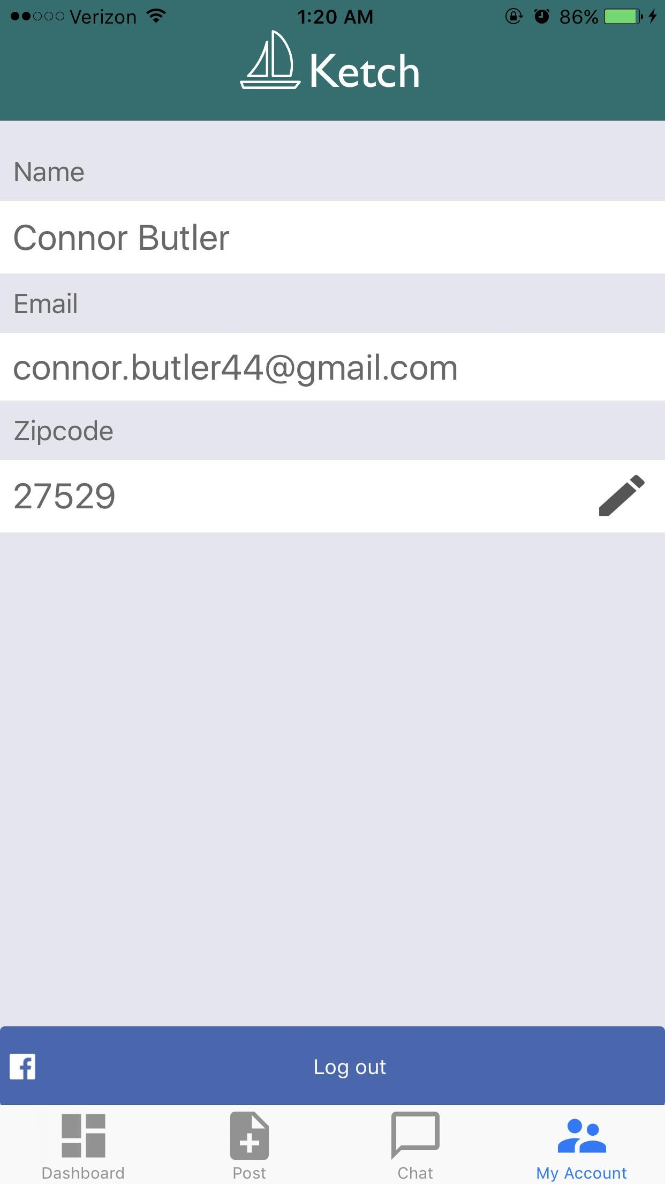
Account Page
User Information Is Stored Here
Zip-Code Is The Only Thing The User Can Change
User Can Logout Of Their Account

Slide 12
In Progress . . .
Accept or Deny Current Offers
Showing Items Based off of Location
Customer Support
Feedback System
Picture Uploads
Stripe
Geotracking(Possibly A Secondary Feature At This point)
Dashboard UI
Items Being Tracked
Search Function
Limiting User Input On Features(Such As Title Or Description)

Slide 13
Questions?

Slide 14
Just In Case . . .

Slide 15
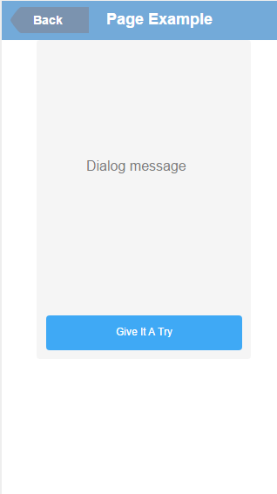


User Training/Tutorial
Basics-
Information Icon will be located in top right-hand corner.
Upon First entering the app, a notification will appear to show the location of the Information Button as well as what it is intended for.
Every Page will have a Information Icon that comes with its own AlertDialog Box when clicked.
Give it a try is a button that will close the dialog box.

Slide 16
Dialog Text
HomePage
Will Focus On User Item Interaction
Small Portion On Buttons Avaliable
Selling Post
Picture Upload/Rules
Desc. And Title Rules
How To Post
Where To Find Post
Item Page
How To Go Back To Homepage
How To Track Item
How To Contact Seller
Messaging Page
Explains Stripe Link
Simple Desc. On How To Type A Message
User Page
Focusing On What The User Can And Cannot Change
Talks About Some Of The Features The User Can See

Slide 17
Questions Pt.2

